Slide 1
Vector Processing

Slide 2



Alternative Model:Vector Processing
Vector processors have high-level operations that work on linear arrays of numbers: "vectors"
SCALAR
(1 operation)
VECTOR
(N operations)
v1
v2
+
+
v3
vector
length
add r3, r1, r2
add.vv v3, v1, v2
Notes:
25

Slide 3
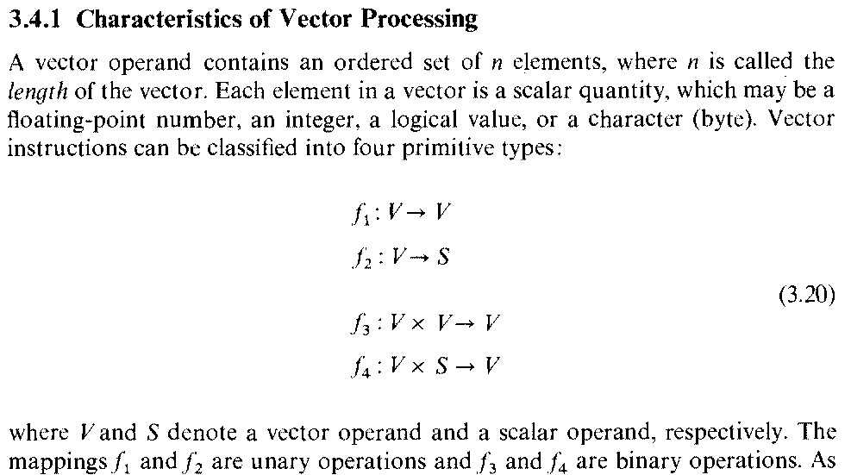

Slide 4
Vector Instruction
Given V- a Vector(operand)
  An ordered set of n elements(n : the length of vector)
    Elements are scalar : floating point number, integer, logical value, character(byte)
Given S- a scalar (operand)
Unary Operation- f1 and f2:
  f1: V V example

Slide 5
Vector Instruction contd….
Unary Operation-f2(Vector Reduction Instruction):
  f2: V S example:
Vi x Vj S (dot product)
Binary Operation- f3 and f4:
  f3: V x V V example:
- f4: V x S V example:

Slide 6
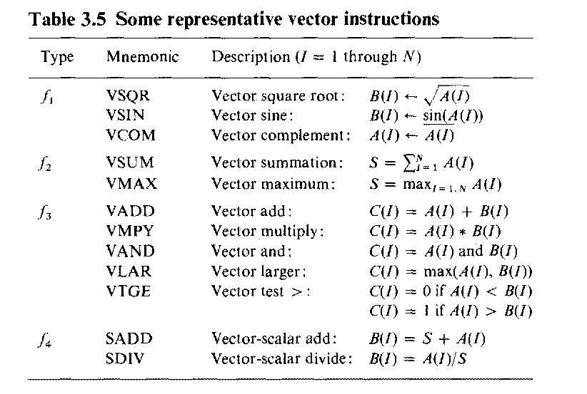

Slide 7
Vector Instruction contd..
Vector – Memory Instruction
  f5 : M V #Vector Load
  f6 : V M #Vector Store
  f7: M V1 x V0 # Vector Gather
  f6: V1 x V0 M # Vector Scatter
  Ref Chapter 8 (Hwang) : page 403

Slide 8
Applications
Vector processing techniques operate in video-game console hardware and in graphics accelerators, weather related data,
Multimedia Processing (compress., graphics, audio synth, image proc.)
  Standard benchmark kernels (Matrix Multiply, FFT, Convolution, Sort)
  Lossy Compression (JPEG, MPEG video and audio) Lossless
  Compression (Zero removal, RLE, Differencing, LZW)
Cryptography (RSA, DES/IDEA, SHA/MD5)
Speech and handwriting recognition
Operating systems/Networking (memcpy, memset, parity, checksum)
Databases (hash/join, data mining, image/video serving)

Slide 9
Vector Processors Contd….

Slide 10
Definitions
Vector
  A set of scalar items all of same type
Stored in memory, vector elements are ordered to have addressing increment between successive elements , that is called stride
Hardware resources
  Vector registers
  Register counters and scalar registers
  Functional Pipelines
    (Vector processing occurs when arithmetic and logical operations are applied to vectors)

Slide 11
Vector Processing
Advantage
  Faster , more efficient than scalar processing
  Reduces software overhead in maintenance of looping control
  Reduces memory access conflicts
  Matches with pipelining and segmentation concepts to generate one result per clock cycle continuously.

Slide 12
Vector Processing
Disdvantage
  Increased hardware cost
  Compiler(Vectorizer) capable of vectorization(conversion of scalar code to vector code) has higher cost

Slide 13
Vector Operand
Entries in matrix may be store in row major or column major way in the memory
  Each row, column, diagonal may be used as a vector
(Note:
Row elements are stored in contiguous locations with a unit stride
Column elements must be stored with stride n ( n is matrix order)
Diagonal of matrix separated by a stride of n+1

Slide 14
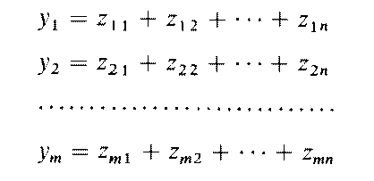
Pipelined Vector Processing Methods
Vector processing involves processing large arrays of data
  Example:
3 Types of Vector Processing Methods
  1) Horizontal Vector Processing
  Vector y calculated in sequential order yi, i=1,…,m
  Not useful for vector processing

Slide 15
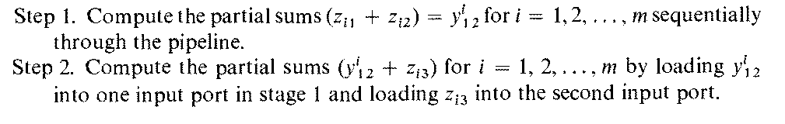
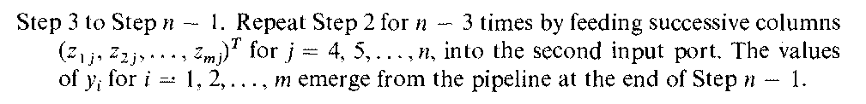
Pipelined Vector Processing Methods contd….
2) Vertical Vector Processing
Number of vector component m is unrestricted, many intermediate results have to be stored
useful for vector processing, but vectors are very large in size

Slide 16
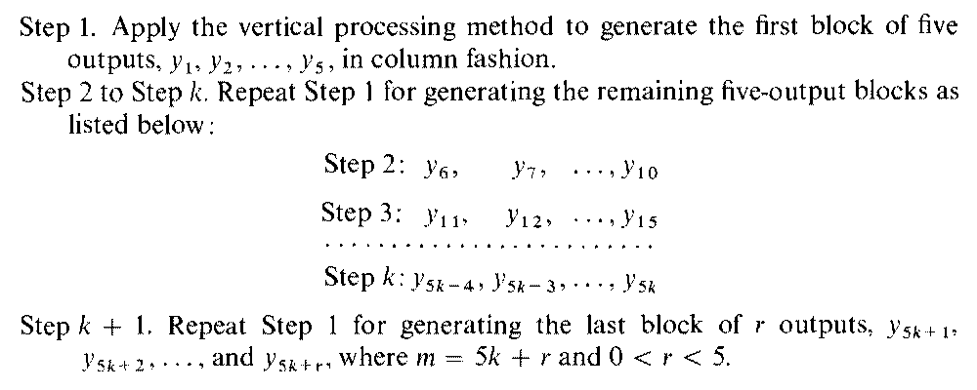
Pipelined Vector Processing Methods contd….
3) Vector Looping Method
Not restricted by vector length m
Intermediate result appear in small blocks of data, therefore suitable for register-register architecture

Slide 17
Vector Operand
For accessing vector from memory
  Base address is needed
  Stride is needed
  Length of the vector is needed
  (All the above are scalar registers that are accessed for getting vector from memory to vector registers of the processor)

Slide 18
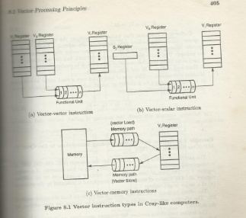

Slide 19
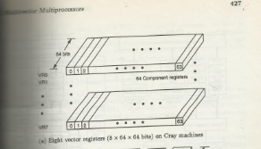

Slide 20
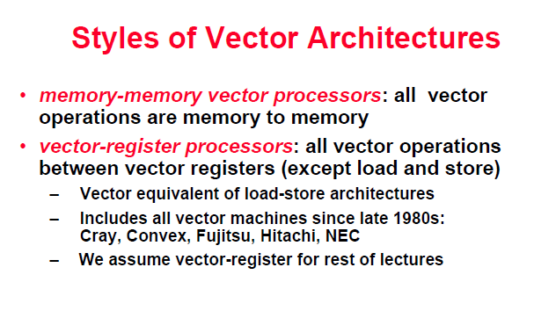
Vector-register processors is same as Register-register processor

Slide 21
Vector Processors Contd….

Slide 22
Vector Operand
Each vector register has a fixed number of component registers
  (Very long vector need to be segmented and processed one segment at a time)

Slide 23
VECTOR LENGTH
vector length of 64(Maximum Vector Length-MVL).
  1. In real world applications vector lengths are not exactly 64.
      adding just first n elements of a vector ,
        Vector Length register(VLR) used for this
      VLR controls the length of any vector operation by defining
      their length.
      value cannot be greater than the length of the vector registers. (64 in this case)
  2. In real world applications, data in vectors in memory can be greater
    than the MVL of the processor.
    we use a technique called Strip Mining

Slide 24
STRIP MINING
Splitting data : each vector operation is done for a size less than or equal to MVL(Maximum Vector Length).
  Done by a simple loop with MOD operator as control point.
  (VL- Vector Length)
low = 0;
VL = (n % MVL); /*find odd-size piece using modulo op % */
for (j = 0; j <= (n/MVL); j=j+1) { /*outer loop*/
for (i = low; i < (low+VL); i=i+1) /*runs for length VL*/
Y[i] = a * X[i] + Y[i] ; /*main operation*/
low = low + VL; /*start of next vector*/
VL = MVL; /*reset the length to MVL*/
}

Slide 25
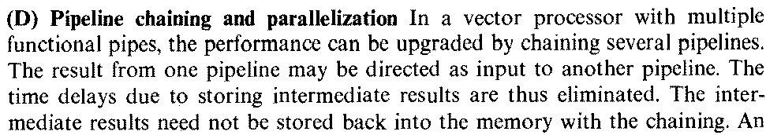
Vector Pipeline Chaining
Hwang and Briggs Page 310
(like data forwarding in scalar pipelinging)
Same functional unit cannot be assigned to execute more than one instruction in the same chain
  Functional Units NEED to be Independent

Slide 26
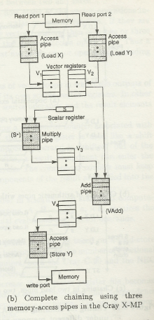
Hwang Page 439 Figure Scan
The result vector of one functional pipeline is made the operand vector of the next functional pipeline, instead of wasting time in copying result to operand vector

Slide 27
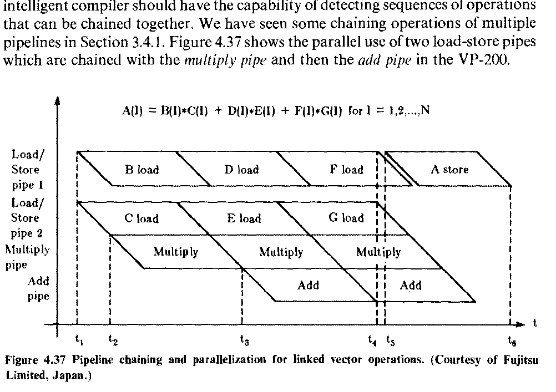

Slide 28
Superscalar processor architectures
Hwang pages 177-178 , 4.2.1,Chapter 6 pages 310 – 311,

Slide 29
Superscalar Processor
Scalar Processor:
  1 instruction per cycle
  1 instruction completion expected from pipeline per cycle
Superscalar Processor:
  Multiple instructions issued per cycle( Exploits more instruction level parallelism in user programs)
    Special compilers used to find instruction level parallelism
  Independent instructions needed
    Can be executed without causing a wait state(stall)
    Average number of independent instructions found in code for parallel operation is 2
      Therefore instruction issue degree limited to 2 to 5 in superscalar processor

Slide 30
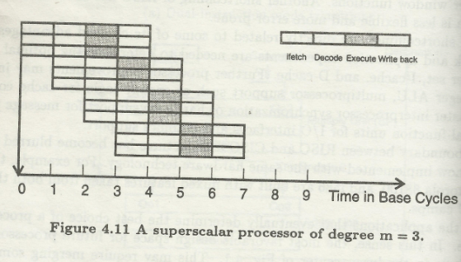
Hwang page 178

Slide 31
Superscalar Processor
Multiple instruction pipelines used
Instruction cache supplies multiple instruction per fetch
Multiple functional units
  integer units and floating point units
Note: Actual number of instruction issued to various functional units vary in each cycle constrained by data dependencies and resource conflicts

Slide 32
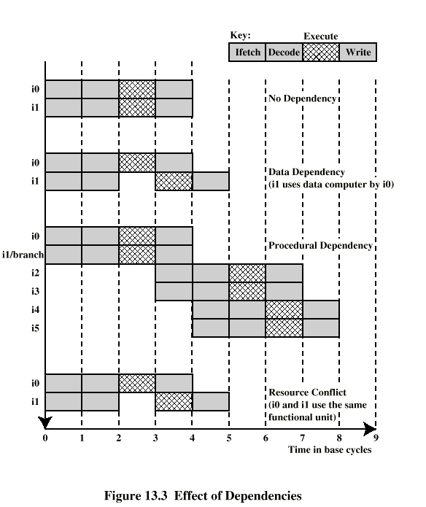
Effect of Dependencies on Superscalar Operation
Notes:
1) Superscalar operation is double impacted by a stall.
2) CISC machines typically have different length instructions and need to be at least partially decoded before the next can be fetched – not good for superscalar operation

Slide 33
Superscalar Processor
Superscalar Performance
  Time required by scalar base machine to execute N independent instruction through pipeline
  T(1,1) = k + N-1(base cycle)
  Ideal execution time required by m-issue superscalar machine
  T(m,1)= k + (N – m)/m(base cycles)
  k - time required to execute first m instructions through m pipelines simultaneously
Ideal speedup of superscaler over base machine
  S(m,1)= T(1,1)/T(m,1) = (N+k-1) /(N/m +k-1)= m(N+k-1)/(N+m(k-1)
  Speedup S(m,1) → m as N→ ∞

Slide 34
Superpipelined processor architectures
Hwang pages 316-318

Slide 35
Superpipelined Processor
In Superpipelined Processor of degree n
  Pipeline cycle time is I/n of base cycle Superpipelined machine of degree n=3 will issue 1 instruction per cycle – cycle time 1/3 of base cycle time
    Single operation latency = n pipeline cycles ≈ 1 base cycle
    ILP required to fully utilize the machine = n instructions
  High speed clock mechanism required

Slide 36
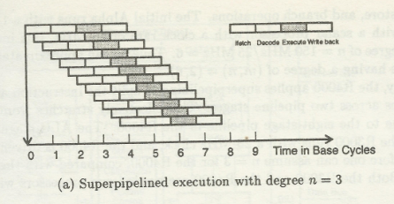
Single Operation
Latency=n
Hwang page 317

Slide 37
Superpipelined Processor
Superpipelined Performance
  Minimum time required to execute N instructions in degree n machine with k stages in pipeline
  T(1,n)= k + 1/n(N-1)
  Speedup(1,n)= T(1,1)/T(1,n)= (k+ N-1)/(k+(N-1)/n))
  = n( k +N-1)/ (nk + N-1)
  Speedup S(1,n) → n as N→ ∞

Slide 38
Superscalar vs Superpipeline
Superscalar design
  Spatial parallelism
    Multiple operations running concurrently on separate hardware (execution units and register file ports), more transistors required (CMOS technology suitable)
Superpipelined design
  Temporal parallelism
    Overlapping multiple operations on common piece of hardware(more deeply pipelined execution units with faster clock cycles( faster transistors required)

Slide 39
Superpipelined Superscalar Performance
Minimum time needed to execute N independent instructions on Superpipelined Superscalar machine of degree(m,n)
  T(m,n)=k+(N-m)/(mn) (base cycles)
Speedup over base machine
  S(m,n)=T(1,1)/T(m,n)= (k+N-1)/ (k+(N-m)/(mn))= mn(k+N-1)/(mnk + N-m)
  Speedup limit S(m,n) → mn as N→ ∞

Slide 40
VLIW processor architectures
Hwang 4.2.2 page 182 to 184

Slide 41
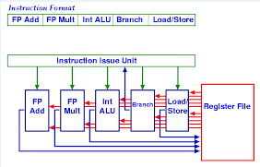
Very Long Instruction Set Word
(100s of bits in length)
A typical VLIW processor and instruction format, degree=3

Slide 42
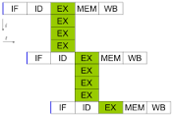
Degree=4,The effective clocks/Instruction (CPI)= ¼= . 25
For VLIW architecture
  Instruction parallelism and data movement completely specified at compile time
    Runtime resource scheduling and synchronization are completely eliminated
    CPI can be lower than superscalar processor

Slide 43
Superscalar vs VLIW
1) Decoding of VLIW instruction is easier
2) Code density of superscalar machine is better, because fixed VLIW format includes bits for non-executable operations while superscalar issues only executable operations
3)Superscalar machines
  Object code compatible with non parallel machines
VLIW m/c exploiting different amounts of parallelism require different instruction set

